Slide 1


HUM 102 Report Writing Skills
Lecture 15

Slide 2

Previous Lecture
The 7 C’s of Effective Communication
Concreteness
Correctness
Consideration
Courtesy

Slide 3


Memorandum
Latin: Bring to remembrance
Type of informal report
Used for communication within an organization

Slide 4


Memorandum
Basics
Interoffice communication
Without formal salutations and closing remarks
Used as a covering note
Cardinal Rule:
All important information must appear on the first page

Slide 5

Memorandum
Structure
Less formal than a letter
In case of no printed memo form, memo or interoffice correspondence at the center and top of the page
Brief and simple (if long, send as an attachment)
Direct information

Slide 6




Memorandum
Key Points
Avoid personal statements
Professional tone
Easy to understand language
Conciseness and clarity should go in line with adequate development of thought

Slide 7

Memorandum
Purpose [1/2]
Important to decide whether memo is the best medium for interaction compared with all other means
Recording and relaying Information
Statement written by higher authorities for the purpose of sharing information
Meeting minutes
Due dates
Persuasion (making brief appeals)
Reaction/Feedback

Slide 8
Memorandum
Purpose [2/2]
Builds good relationship
Establishes accountability
Motivates employees
Issues a directive
Provide a report

Slide 9

Memorandum
Effective Elements
Grabs the reader's attention
Provides information, makes a recommendation, or asks for action
Explains benefits to reader
Mentions next steps and deadlines
May be used to explain author’s opinion(s)

Slide 10

Memorandum
Audience Analysis
Typical Audience:
Co-workers and colleagues ➔ focus on the main point
Separate department:
Less familiar ➔ provide a detailed background
Always good to provide a context

Slide 11

Memorandum
Guidelines and Tips [1/2]
Clear subject line
State your purpose in the first paragraph
Summarize any potential objections
Keep paragraphs short
Use subheads between paragraph groups
Use bulleted and numbered lists
Request action

Slide 12
Memorandum
Guidelines and Tips [2/2]
Include as much information as necessary
Be concise but convincing
Include lists, charts and graphs at the end
Mention how these attachments are important

Slide 13

Memorandum
Types
Information Memo
Problem Solving Memo
Persuasion Memo
Internal Memo Proposal
Directive Memo
Response to an Inquiry Memo
Trip Report Memo
Field Report/Lab Report Memo

Slide 14
Memorandum
Types: Information Memo
Used to deliver or request information or assistance
First paragraph provides main idea
Second paragraph expands on the details
Third paragraph outlines the action required

Slide 15
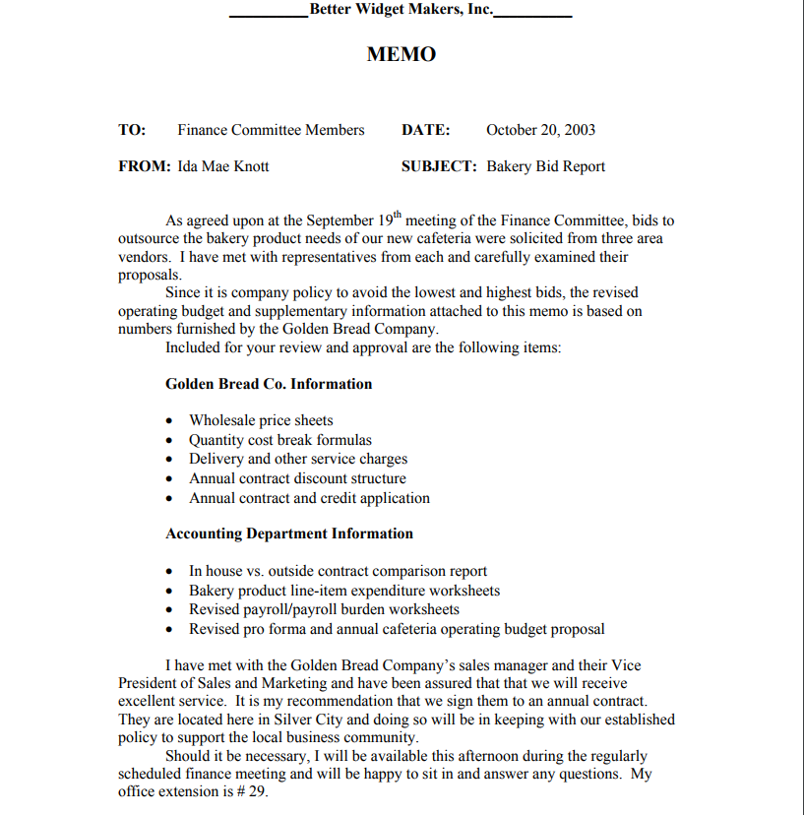

Reference: https://writing.colostate.edu/guides/documents/business_writing/business_memos/informational/sampleinformationalmemo.pdf

Slide 16
Memorandum
Types: Problem Solving Memo
Suggests a specific action to improve a situation
First paragraph states the problem
Second paragraph analyzes the problem
Third paragraph makes a recommendation
When making a recommendation, include not only the positive details but also the drawbacks and diffuse them yourself

Slide 17
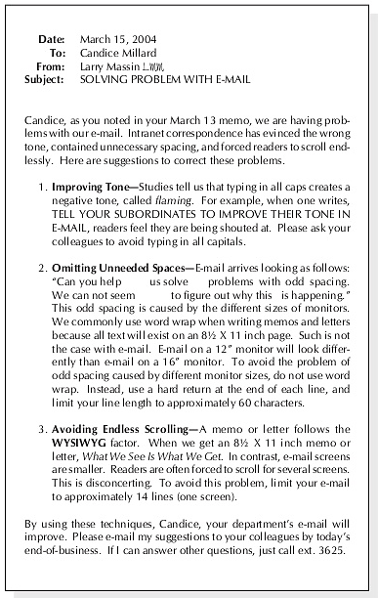
Reference: https://image.slidesharecdn.com/tbwritingbook-140206004733-phpapp01/95/tb-writing-book-40-638.jpg?cb=1391647668

Slide 18
Memorandum
Types: Persuasion Memo
Used to encourage the reader to undertake an action he or she doesn't have to take
First part begins with an agreeable point
Second part introduces the idea
Third part states benefits to the reader
Fourth part outlines the action required
Final part ends with a call to action

Slide 19
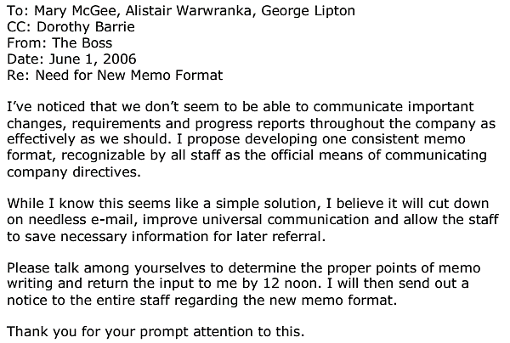
Reference: http://www.lupinworks.com/roche/pages/memos.php

Slide 20
Memorandum
Types: Internal Memo Proposal
Used to convey suggestions to senior management
First part states reason for writing
Second part outlines present situation and states writer's proposal
Third part describes advantage(s)
Fourth part mentions and diffuses disadvantage(s)
Fifth part ends with a call to action

Slide 21
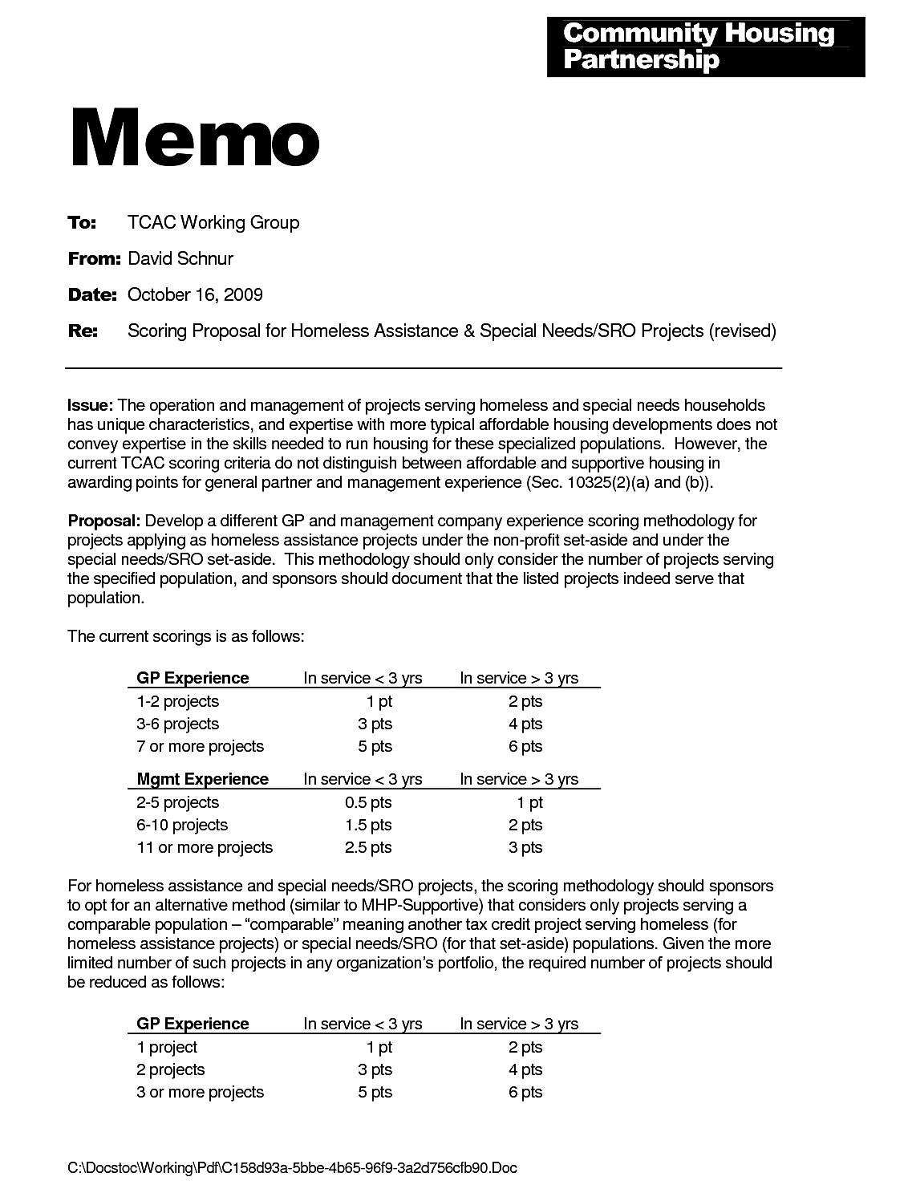
Reference: http://protectletters.net/wp-content/uploads/2017/05/memorandum-proposal-example-business-proposal-memo-example_408154.png

Slide 22
Memorandum
Types: Directive Memo
States a policy or procedure you want the reader or co-worker to follow
Length depends on space required for explanation
Beginning: clear and concise statement of purpose
Example: The purpose of this memo is to let all members of the ABC Department know that doughnuts will be provided every Friday morning at 9:00 AM.
Purpose is followed by statements providing a rationale

Slide 23
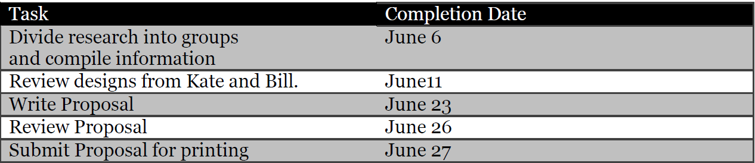
Reference: http://writing.colostate.edu/guides/documents/memo/pop2c.cfm
To: Design Team #362
From: W.B. Working
Date: May 27, 1997
Subject: Project Schedule
As A result of yesterday's meeting, I suggest we follow the project schedule listed below. Remember, we must submit a proposal by noon on July 2.

Slide 24
Memorandum
Types: Response Memo
To provide the audience with desired information.
First part states purpose statement (to respond to a request)
Second summarizes the requested information.
Third part has a discussion, highlighting and emphasizing the important information
Final part is call to action.
State the additional action to be taken to rightly address the issue

Slide 25
Reference: http://writing.colostate.edu/guides/documents/memo/pop2c.cfm
To: Design Team #362
From: W.B. Working
Date: May 27, 1997
Subject: Project Schedule
Purpose: This memo responds to your request that the weekly meeting be moved from 9am to 10am.
Summary: This request is satisfactory as long as it is approved by management.
Discussion: Management usually has no problem with the individual time changes in meetings, as long as meeting minutes are turned in by noon to Cathy.
Action: I have asked Cathy if she thinks this would be a problem and she said no, so all we need to do now is get approval from Steve.

Slide 26
Memorandum
Types: Trip Report Memo
To a supervisor after an employee returns from a business venture
First part has statement of purposes, i.e., provides information on trip
Second summarizes clearly and concise (ideally!) outline of your trip
Third part involves a discussion (highlight and emphasize important information)
Final part includes action to be taken to rightly address the issue

Slide 27
Reference: http://writing.colostate.edu/guides/documents/memo/pop2c.cfm
To: Design Team #362
From: W.B. Working
Date: June 27, 1997
Subject: Weekly Meeting
Purpose: This memo presents my impressions of the meeting last week at ABC organization in XYZ country.
Summary: In general, I felt that the meeting went well and much progress was made.
Discussion: Barb and Jeff were able to make progress on the graphics and should have them finished next week. Kyle and Sandy are on chapter 2 of the user manual.
Recommendation: Kyle will meet with Jeff to see how they want the graphics integrated into the text.

Slide 28
Memorandum
Types: Field Report Memo
To report on inspection and procedures
It is divided into following parts:
Purpose
Summary
Problem
Method
Results
Conclusion
Recommendation

Slide 29
Reference: http://writing.colostate.edu/guides/documents/memo/pop2c.cfm
To: Dean of Journalism
From: Steve Nash
Date: June 27, 1999
Subject: Computer Lab
Purpose: This memo presents my the findings of my visit to the computer lab at Clark c252.
Summary: In general, I felt that the lab needs new equipment and renovation.
Problem: The inspection was designed to determine if the present equipment was adequate to provide graduate students with the technology needed to perform the tasks expected of them by their professors and thesis research.
Methods: I ran a series of tasks on SPSS and WordPerfect, and recorded memory capacity and processing time for each task.
Results: The inspection found that the hardware used to run the computers is outdated and that the computers themselves are very slow.
Conclusions: This lab is inadequate for the everyday needs of graduate students in this department.
Recommendations: Four new computers running on windows 10 and a processing speed of at least 2.0ghz with four cores should be purchased immediately.

Slide 30
Conclusions
Basics of Memo
Purpose of Memo
Structure of Memo
Types of Memo

